Slide 1
For our HEALTH…
Presentation for Ventura County
Board of Supervisors Meeting
June 24, 2014

Slide 2
Long List of Studies linking glyphosate
To CANCER
To Autism
To Crohn’s Disease
To Colitis
To Allergies
To Alzheimer's
To Auto Immune Disease
To Asthma
To Birth Defects, Infertility, & Sterility

Slide 3
List of References on the Health Effects of Glyphosate (Roundup)
Bellé, R., Le Bouffant, R., Morales, J., Cosson, B., Cormier, P., Mulner-Lorillon, O. 2007. Sea urchin embryo, DNA-damaged cell cycle checkpoint and the mechanisms initiating cancer development. J. Soc. Biol. 201, 317–327.
Belmonte, R.V. 2006. Victims of glyphosate. IPS News, March 16. http://ipsnews.net/news.asp?idnews=32528
Benachour, N., Séralini, G-E. 2009. Glyphosate formulations induce apoptosis and necrosis in human umbilical, embryonic, and placental cells. Chem. Res. Toxicol. 22, 97–105.
Benachour, N., Séralini, G-E. 2009. Glyphosate formulations induce apoptosis and necrosis in human umbilical, embryonic, and placental cells. Chem. Res. Toxicol. 22, 97–105.
Benachour, N., Sipahutar, H., Moslemi, S., Gasnier, C., Travert, C., Séralini, G-E. 2007. Time- and dose-dependent effects of roundup on human embryonic and placental cells. Archives of Environmental Contamination and Toxicology 53, 126–33.
Benbrook, C.M. 2009. Impacts of genetically engineered crops on pesticide use in the United States: The first thirteen years. The Organic Center, November. http://www.organic-center.org/reportfiles/13Years20091126_FullReport.pdf
Benitez-Leite, S., Macchi, M.A., Acosta, M. 2009. Malformaciones congénitas asociadas a agrotóxicos. Arch. Pediatr. Drug 80, 237–247. Branford, S. 2004. Argentina’s Bitter Harvest. New Scientist, April 17, 40-43. Brasil, F.B., Soares, L.L., Faria, T.S., Boaventura, G.T., Sampaio, F.J., Ramos, C.F. 2009. The impact of dietary organic and transgenic soy on the reproductive system of female adult rat. Anat Rec (Hoboken) 292, 587–94.

Slide 4
Carrasco, A. 2010. Interview with journalist Dario Aranda, August. Cessna, A.J., Cain, N.P. 1992. Residues of glyphosate and its metabolite AMPA in strawberry fruit following spot and wiper applications. Can. J. Plant Sci. 72, 1359-1365.
Colombian court suspends aerial spraying of Roundup on drug crops. Reuters, July 27, 2001. http://www.mindfully.org/Pesticide/Roundup-Drug-Spray-Colombia.htm
Dallegrave, E., Mantese, F.D., Coelho, R.S., Pereira, J.D., Dalsenter, P.R., Langeloh, A. 1993. The teratogenic potential of the herbicide glyphosate- Roundup in Wistar rats. Toxicol. Lett. 142, 45-52.
De Roos, A.J., Blair, A., Rusiecki, J.A., Hoppin, J.A., Svec, M., Dosemeci, M., Sandler, D.P., Alavanja, M.C. 2005. Cancer incidence among glyphosate-exposed pesticide applicators in the Agricultural Health Study. Environ Health Perspect. 113, 49–54.
Eriksson, M., Hardell, L., Carlberg, M., Akerman, M. 2008. Pesticide exposure as risk factor for non-Hodgkin lymphoma including histopathological subgroup analysis. International Journal of Cancer 123,1657–1663.
FAO. 2005. Pesticide residues in food - 2005. Evaluations, Part I: Residues (S. 477). http://www.fao.org/docrep/009/a0209e/a0209e0d.htm
FAO. 2005. Pesticide residues in food – 2005. Report of the Joint Meeting of the FAO Panel of Experts on Pesticide Residues in Food and the Environment and the WHO Core Assessment Group on Pesticide Residues, Geneva, Switzerland, 20–29 September. FAO Plant Production and Protection Paper 183, 7.
FAO. 2005. Pesticide residues in food – 2005. Report of the Joint Meeting of the FAO Panel of Experts on Pesticide Residues in Food and the Environment and the WHO Core Assessment Group on Pesticide Residues, Geneva, Switzerland, 20–29 September. FAO Plant Production and Protection Paper 183, 7.

Slide 5
FAO. Pesticide residues in food – 1997: Report. Report of the Joint Meeting of the FAO Panel of Experts on Pesticide Residues in Food and the Environment and the WHO Core Assessment Group on Pesticide Residues. Lyons, France, 22 September – 1 October 1997. http://www.fao.org/docrep/w8141e/w8141e0u.Htm
Fog, L. 2007. Aerial spraying of herbicide “damages DNA”. SciDev.net, May 17, 2007. http://www.scidev.net/en/news/aerial-spraying-of-herbicide-damages-dna.html
Gasnier, C., Dumont, C., Benachour, N., Clair, E., Chagnon, M.C., Séralini, G-E. 2009. Glyphosate-based herbicides are toxic and endocrine disruptors in human cell lines. Toxicology 262, 184–191.
George, J., Prasad, S., Mahmood, Z., Shukla, Y. 2010. Studies on glyphosateinduced carcinogenicity in mouse skin. A proteomic approach. J. of Proteomics 73, 951–964.
Haefs, R., Schmitz-Eiberger, M., Mainx, H.G., Mittelstaedt, W., Noga, G. 2002. Studies on a new group of biodegradable surfactants for glyphosate. Pest Manag. Sci. 58, 825–833.
Hardell, L., Eriksson, M. A. 1999. Case-control study of non-Hodgkin lymphoma and exposure to pesticides. Cancer 85, 1353–60.
Hardell, L., Eriksson, M., Nordstrom, M. 2002. Exposure to pesticides as risk factor for non-Hodgkin’s lymphoma and hairy cell leukemia: Pooled analysis of two Swedish case-control studies. Leuk Lymphoma 43, 1043-9.
Hietanen, E., Linnainmaa, K., Vainio, H. 1983. Effects of phenoxy herbicides and glyphosate on the hepatic and intestinal biotransformation activities in the rat. Acta Pharma et Toxicol 53, 103–112.

Slide 6
Kelly, D.W., Poulin, P., Tompkins, D.M., Townsend, C.R. 2010. Synergistic effects of glyphosate formulation and parasite infection on fish malformations and survival. J. Appl. Ecology 47, 498–504.
Malatesta, M., Biggiogera, M., Manuali, E., Rocchi. M.B., Baldelli, B., Gazzanelli, G. 2003. Fine structural analysis of pancreatic acinar cell nuclei from mice fed on GM soybean. Eur J Histochem. 47, 385–8.
Malatesta, M., Boraldi, F., Annovi, G., Baldelli, B., Battistelli, S., Biggiogera, M., Quaglino, D. 2008. A long-term study on female mice fed on a genetically modified soybean: effects on liver ageing. Histochem Cell Biol. 130, 967–77.
Malatesta, M., Caporaloni, C., Gavaudan, S., Rocchi, M.B., Serafini, S., Tiberi, C., Gazzanelli, G. 2002. Ultrastructural morphometrical and immunocytochemical analyses of hepatocyte nuclei from mice fed on genetically modified soybean. Cell Struct Funct. 27, 173–180.
Malatesta, M., Perdoni, F., Santin, G., Battistelli, S., Muller, S., Biggiogerra, M. 2008. Hepatoma tissue culture (HTC) cells as a model for investigating the effects of low concentrations of herbicide on cell structure and function. Toxicol. in Vitro 22, 1853–1860.
Mañas, F., Peralta, L., Raviolo, J., Garci, O.H., Weyers, A., Ugnia, L., Gonzalez, C.M., Larripa, I., Gorla, N. 2009. Genotoxicity of AMPA, the environmental metabolite of glyphosate, assessed by the Comet assay and cytogenetic tests. Ecotoxicology and Environmental Safety 72, 834–837.
Mañas, F., Peralta, L., Raviolo, J., Garcia Ovando, H., Weyers, A., Ugnia, L., Gonzalez Cid, M., Larripa, I., Gorla, N. 2009. Genotoxicity of AMPA, the environmental metabolite of glyphosate, assessed by the Comet assay and cytogenetic tests. Ecotoxicology and Environmental Safety 72, 834–837.
Mañas, F., Peralta, L., Raviolo, J., Garcia Ovando, H., Weyers, A., Ugnia, L., Gonzalez Cid, M., Larripa, I., Gorla, N. 2009. Genotoxicity of AMPA, the environmental metabolite of glyphosate, assessed by the Comet assay and cytogenetic tests. Ecotoxicology and Environmental Safety 72, 834–837.

Slide 7
Mañas, F., Peralta, L., Raviolo, J., Garcia, O.H., Weyers, A., Ugnia, L., Gonzalez, C.M., Larripa, I., Gorla, N. 2009. Genotoxicity of glyphosate assessed by the Comet assay and cytogenic tests. Environ. Toxicol. Pharmacol. 28, 37–41.
Marc, J., Bellé, R., Morales, J., Cormier, P., Mulner-Lorillon, O. 2004. Formulated glyphosate activates the DNA-response checkpoint of the cell cycle leading to the prevention of G2/M transition. Toxicological Sciences 82, 436–442.
Marc, J., Mulner-Lorillon, O., Bellé, R. 2004. Glyphosate-based pesticides affect cell cycle regulation. Biology of the Cell 96, 245–249. Marc, J., Mulner-Lorillon, O., Boulben, S., Hureau, D., Durand, G., Bellé, R. 2002. Pesticide Roundup provokes cell division dysfunction at the level of CDK1/ cyclin B activation. Chem Res Toxicol. 15, 326–31.
Marc, J., Mulner-Lorillon, O., Boulben, S., Hureau, D., Durand, G., Bellé, R. 2002. Pesticide Roundup provokes cell division dysfunction at the level of CDK1/ cyclin B activation. Chem. Res Toxicol. 15, 326–331.
Meadows, R. 2005. Common herbicide lethal to wetland species. Conservation Magazine 6, July-September. http://www.conservationmagazine.org/2008/07/common-herbicide-lethal-to-wetland-species/ Monsanto fined in France for “false” herbicide ads. Agence France Presse, Jan 26, 2007. http://www.organicconsumers.org/articles/article_4114.cfm Newmaster, S.G., Bell, F.W., Vitt, D.H. 1999. The effects of glyphosate and triclopyr on common bryophytes and lichens in northwestern Ontario. Can. Jour. Forest Research 29, 1101–1111.

Slide 8
Paganelli, A., Gnazzo, V., Acosta, H., López, S.L., Carrasco, A.E. 2010. Glyphosate-based herbicides produce teratogenic effects on vertebrates by impairing retinoic acid signalling. Chem. Res. Toxicol., August 9. http://pubs.acs.org/doi/abs/10.1021/tx1001749
Paraguay’s Painful Harvest. Unreported World. 2008. Episode 14. First broadcast on Channel 4 TV, UK, November 7. http://www.channel4.com/programmes/unreported-world/episode-guide/series-2008/episode-14/
Paz-y-Miño, C., Sánchez, M.E., Arévalo, M., Muñoz, M.J., Witte, T., De-la- Carrera, G.O., Leone, P. E. 2007. Evaluation of DNA damage in an Ecuadorian population exposed to glyphosate. Genetics and Molecular Biology 30, 456-460. Pesticide safety limit raised by 200 times ‘to suit GM industry’. Daily Mail, September 21, 1999. http://www.connectotel.com/gmfood/dm210999.txt
Pryme, I.F., Lembcke, R. 2003. In vivo studies of possible health consequences of genetically modified food and feed – with particular regard to ingredients consisting of genetically modified plant materials. Nutrition and Health 17, 1–8.
Pusztai, A. 2001. Genetically modified foods: Are they a risk to human/ animal health? ActionBioscience.org. http://www.actionbioscience.org/biotech/pusztai.html
Relyea, R. 2005. Roundup is highly lethal. Dr Relyea responds to Monsanto’s concerns regarding recent published study. April 1. http://www.mindfully.org/GE/2005/Relyea-Monsanto-Roundup1apr05.htm
Relyea, R.A. 2005. The impact of insecticides and herbicides on the biodiversity and productivity of aquatic communities. Ecol. Appl. 15, 618–627. Relyea, R.A., Schoeppner, N. M., Hoverman, J.T. 2005.
Pesticides and amphibians: the importance of community context. Ecological Applications 15, 1125–1134. Richard, S., Moslemi, S., Sipahutar, H., Benachour, N., Séralini, G-E. 2005. Differential effects of glyphosate and Roundup on human placental cells and aromatase. Environmental Health Perspectives 113, 716–20.

Slide 9
Romig, S. 2010. Argentina court blocks agrochemical spraying near rural town. Dow Jones Newswires, March 17. http://bit.ly/cg2AgG Russia says genetically modified foods are harmful. Voice of Russia, April 16, 2010 (Unpublished as at August 2010). http://english.ruvr.ru/2010/04/16/6524765.html
Santillo, D.J., Brown, P.W., Leslie, D.M. 1989. Response of songbirds to glyphosate-induced habitat changes on clearcuts. J. Wildlife Management 53, 64–71.
Savitz, D.A., Arbuckle, T., Kaczor, D., Curtis, K.M. 1997. Male pesticide exposure and pregnancy outcome. Am. J. Epidemiol. 146, 1025–1036.
Schuette, J. 1998. Environmental fate of glyphosate. Environmental Monitoring & Pest Management, Dept of Pesticide Regulation, Sacramento, CA.
Séralini, G.-E., Cellier, D., de Vendomois, J.S. 2007. New analysis of a rat feeding study with a genetically modified maize reveals signs of hepatorenal toxicity. Arch. Environ Contam Toxicol. 52, 596–602.
Servizi, J.A., Gordon, R.W., Martens, D.W., 1987. Acute toxicity of Garlon 4 and Roundup herbicides to salmon, Daphnia and trout. Bull. Environ. Contam. Toxicol. 39, 15–22.
Soso, A.B., Barcellos, L.J.G., Ranzani-Paiva, M.J., Kreutz, L.K., Quevedo, R.M., Anziliero, D., Lima, M., Silva, L.B., Ritter, F., Bedin, A.C., Finco, J.A. 2007. Chronic exposure to sub-lethal concentration of a glyphosate-based herbicide alters hormone profiles and affects reproduction of female Jundiá (Rhamdia quelen). Environmental Toxicology and Pharmacology 23, 308–313.
Springett, J.A., Gray, R.A.J. 1992. Effect of repeated low doses of biocides on the earthworm Aporrectodea caliginosa in laboratory culture. Soil Biol. Biochem. 24, 1739–1744.
Tate, T.M., Spurlock, J.O., Christian, F.A., 1997. Effect of glyphosate on the development of Pseudosuccinea columella snails. Arch. Environ. Contam. Toxicol. 33, 286–289.

Slide 10
Tudisco, R., Lombardi, P., Bovera, F., d’Angelo, D., Cutrignelli, M. I., Mastellone, V., Terzi, V., Avallone, L., Infascelli, F. 2006. Genetically modified soya bean in rabbit feeding: detection of DNA fragments and evaluation of metabolic effects by enzymatic analysis. Animal Science 82, 193–199.
Tudisco, R., Mastellone, V., Cutrignelli, M.I, Lombardi, P, Bovera, F., Mirabella, N., Piccolo, G., Calabro, S., Avallone, L., Infascelli, F. 2010. Fate of transgenic DNA and evaluation of metabolic effects in goats fed genetically modified soybean and in their offsprings. Animal.
Vecchio, L., Cisterna, B., Malatesta, M., Martin, T.E., Biggiogera, M. 2004. Ultrastructural analysis of testes from mice fed on genetically modified soybean. Eur J Histochem. 48, 448–454.
And the list goes on…

Slide 11
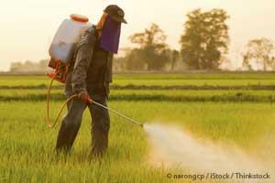
Glyphosate, the active ingredient in Monsanto’s Roundup herbicide, is possibly "the most important factor in the development of multiple chronic diseases and conditions that have become prevalent in Westernized societies”, according to Dr. Stephanie Seneff, research scientist at MIT.

Slide 12
Dr. Seneff has revealed how glyphosate wrecks human health.

Slide 13
Monsanto has steadfastly claimed that Roundup is harmless to animals and humans because the mechanism of action it uses (which allows it to kill weeds), called the shikimate pathway, is absent in all animals.

Slide 14
However, the shikimate pathway IS present in bacteria, and that’s the key to understanding how it causes such widespread systemic harm in both humans and animals.

Slide 15
The bacteria in your body outnumber your cells by 10 to one.
For every cell in your body, you have 10 microbes of various kinds, and all of them have the shikimate pathway, so they will all respond negatively to the presence of glyphosate!

Slide 16
Glyphosate causes extreme disruption of the microbe’s function and lifecycle. What’s worse, glyphosate preferentially affects beneficial bacteria, allowing highly toxic pathogens to overgrow and take over.

Slide 17
Glyphosate is a patented ANTIBIOTIC that destroys gut bacteria, where 70% of our immune system lies.
Crohn's disease (damaged gut) has increased 79% in the past ten years in children admitted to hospitals.
Colitis (stomach ulcers) has tripled.
Allergies, autism, auto immune and asthma now impacts 1 out of 3 of our children.

Slide 18
Glyphosate is an acknowledged endocrine disruptor.
Endocrine disruptors are chemicals that, at certain doses, can interfere with the endocrine (or hormone system) in mammals. These disruptions can cause cancerous tumors, birth defects, and other developmental disorders. Any system in the body controlled by hormones can be derailed by hormone disruptors.

Slide 19
Glyphosate BREAKS DOWN THE BLOOD BRAIN BARRIER: allowing toxins into the brain.
Someone dies of Alzheimer's every 67 seconds in America today.
In 20 years from now, 1 out of 2 of our children will have autism if we continue at this rate.

Slide 20
Glyphosate is a CHELATOR: It holds or "makes unavailable" the vital nutrients of any living thing.

Slide 21
Vitamin deficiency is consistent in cancer patients. Cancer is now the #1 killer of American children today.
More children die every year of cancer than all the 3,000 casualties of 9/11.
1 out of 2 males and 1 out of 3 females are expected to get cancer in America.
Over 117 million Americans have cancer.

Slide 22
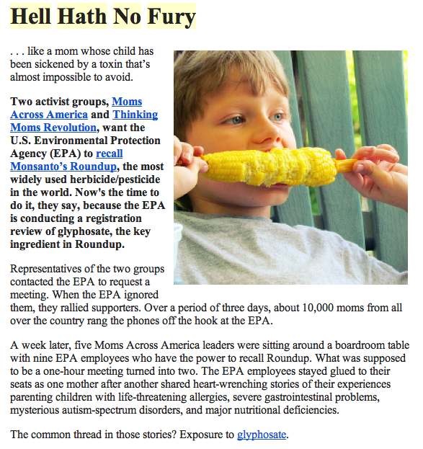
Moms Across America

Slide 23
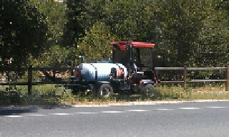

Slide 24
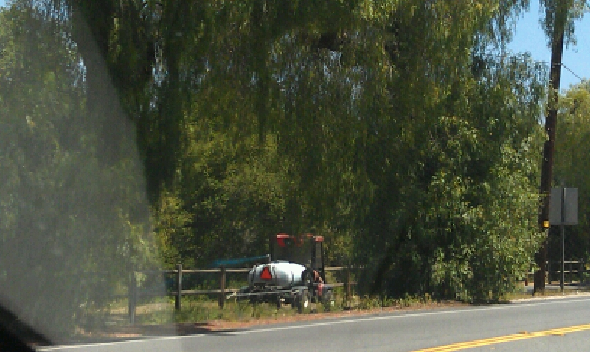

Slide 25
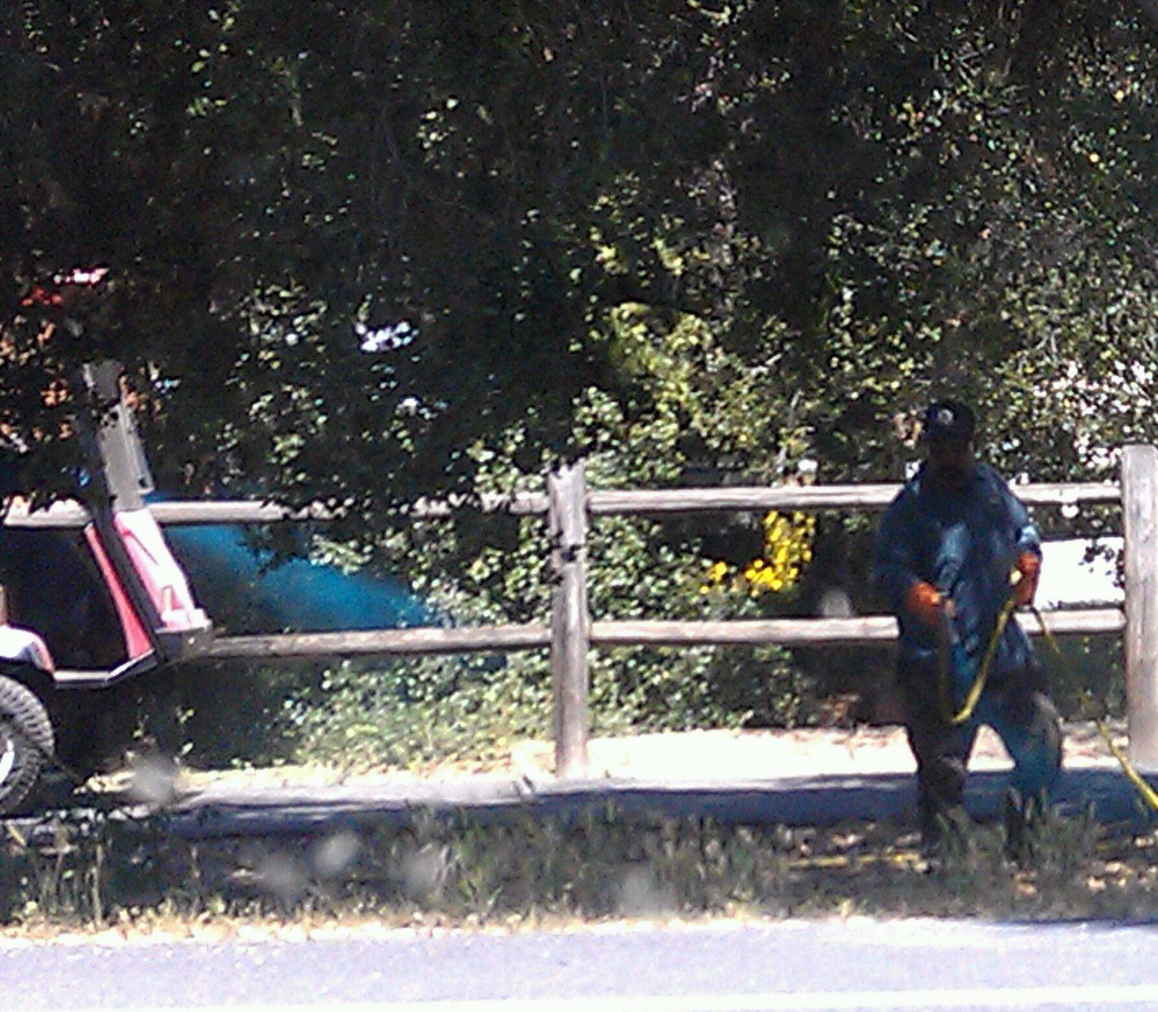

Slide 26
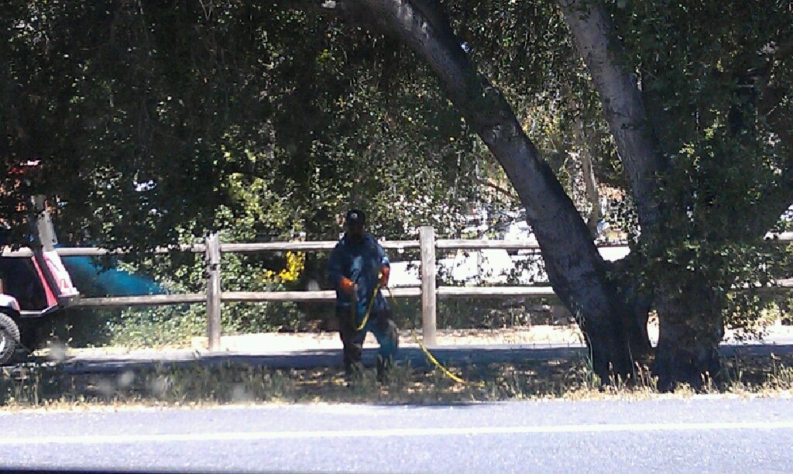

Slide 27


Slide 28
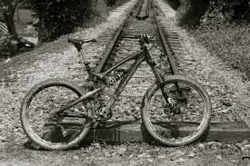

Slide 29


Slide 30
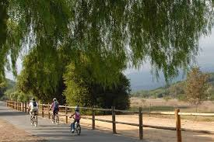

Slide 31


Slide 32


Slide 33
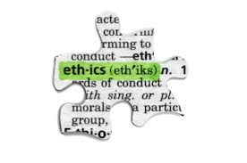

Slide 34


Slide 35


Slide 36


Slide 37
Let’s work together…
to create a healthy, sustainable Ventura for the sake of ourselves, our children and grandchildren, our pets and wildlife that share this beautiful County with us.
Thank you…
Moms Across America
Transition to Organics
Ojai Wildlife League

