Slide 1
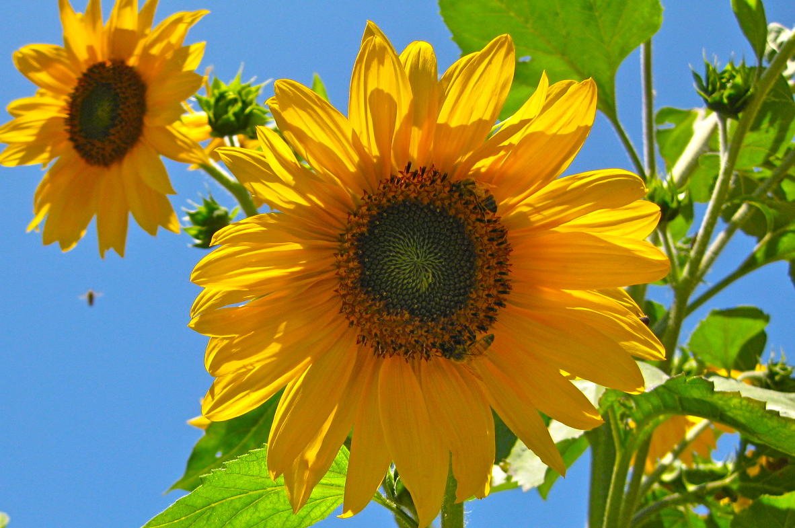
Transition to Organics!
www.transition-to-organics.org

Slide 2
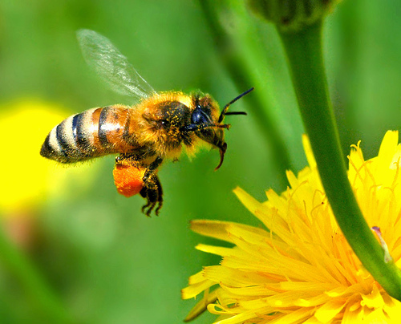
Transition to Organics
TTO is a non-profit organization committed to inspiring and educating land stewards, offering workshops, conferences and hands-on advice about how to build self-nourishing systems which create healthy farms, gardens and communities.

Slide 3
2011 Ojai Valley Wide Discussion:
Next steps to make Ojai Valley a model green & sustainable community
Support biodiversity and grow healthy soil, thereby allowing the ecosystem to regenerate, and eliminate the need to use toxic pesticides and synthetic fertilizers.
According to a USDA study, researchers show that Organic Farming Enhances Biodiversity and Natural Pest Control.

Slide 4
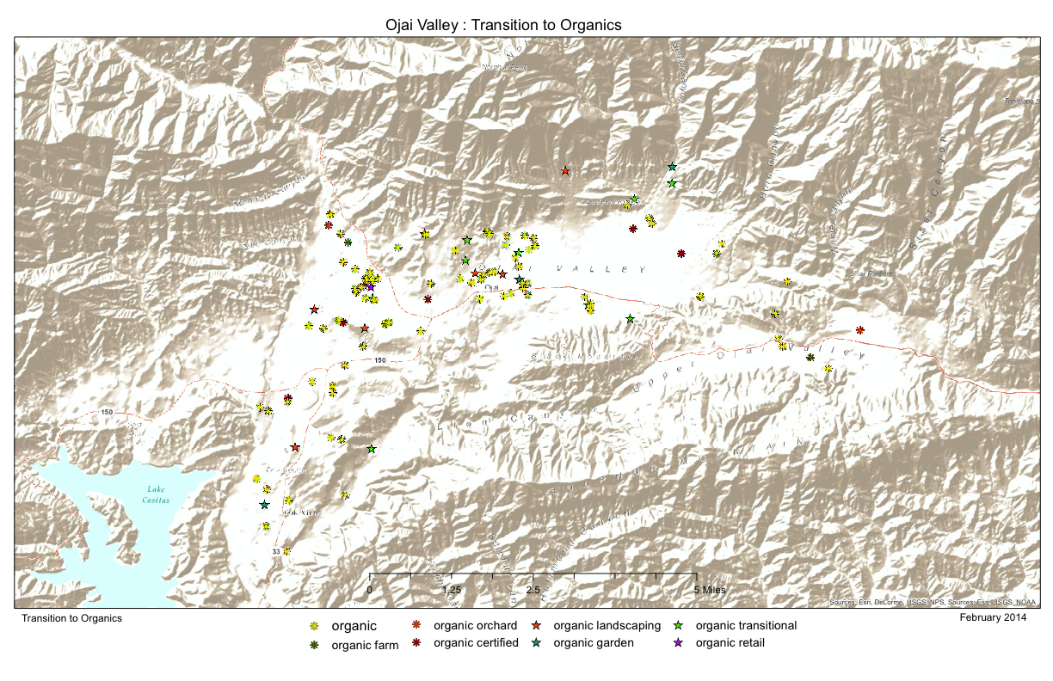
Organic Ojai Map Project

Slide 5
Compost!
Compost is the ultimate ingredient for building fertile soil.
If everyone composted their kitchen and
garden waste, the world would be a
cleaner place, and we would all enjoy more
productive organic gardens.

Slide 6
Making your own compost
1. Buy or build a compost bin.
2. Pick the perfect spot for your compost heap or bin
3. Let the worms do the hard work
4. Put the right stuff in (pesticide/herbicide free, organic)
5. Don’t put the wrong stuff in (no meat)
6. Get the balance right
7. Give it a good airing
8. Boost to the system
9. Turn fallen leaves into compost too
10. Getting the best out of your compost

Slide 7
INSTRUCTIONS FOR FAST COMPOSTING
shredded leaves (about 2/3 by volume)
fresh grass clippings (about 1/3 by volume, or slightly more for faster decomposition)
kitchen scraps (grind in blender)
Begin the pile with a 4" layer of leaves. Add a 2" layer of grass clippings. Repeat the layers until the pile is about 4' high, then add the kitchen scraps.
Chop vertically through the pile with the tines of a pitchfork to thoroughly bruise and mix the materials. Add just enough water to moisten the pile, then cover it with a black plastic garbage bag. Using the same chopping technique, turn the pile on the second day after the pile is built, again on the fourth day, then every three days until the compost is finished. Except in dry weather, no further watering should be necessary.
The compost should be finished in about two weeks. (An unattended pile made with unshredded material may take longer than a year to decompose.)

Slide 8
Herbicide Carryover in Hay, Manure, Compost, and Grass Clippings
Many farmers and home gardeners have reported damage
to vegetable and flower crops after applying horse or
livestock manure, compost, hay, and grass clippings to the
soil.
Symptoms reported include poor seed germination;
death of young plants; twisted, cupped, and
elongated leaves; misshapen fruit; and reduced yields.
Symptoms can be caused by herbicide drift and the
presence of herbicides in the manure, compost, hay, or
grass clippings applied to the soil.

Slide 9
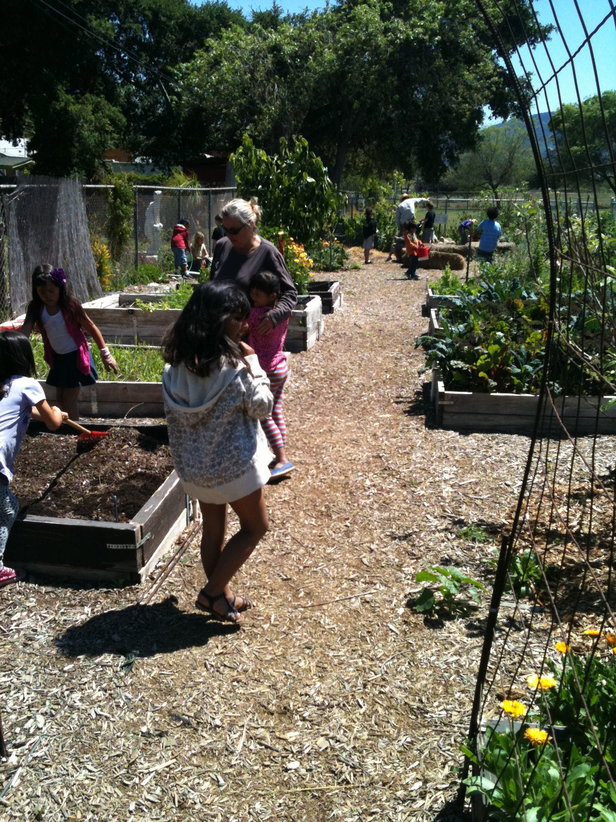
Transition to Organics is raising funds to support Ojai’s school gardens.
We are working with Food For Thought Ojai, to support, educate and inspire school children and their families to make healthier food choices.
School Garden Project
Meiners Oaks Elementary School Garden
April 17, 2013

Slide 10
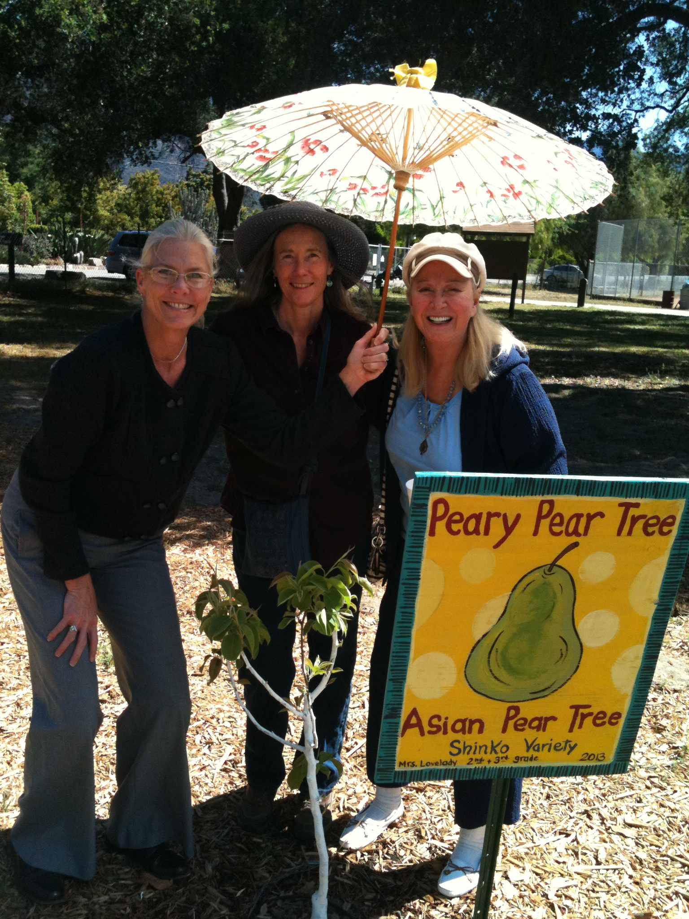
San Antonio School Garden
Many Thanks to Diane Ladd and the “Heaven Sent” program, part of the Art and Culture TaskForce, for their generous contribution to Transition to Organics’ School Gardens Project, making it possible for us to donate biodynamic compost to the school gardens. We deeply appreciate Diane’s commitment to help supply healthy food for the children in our community.
In Photo from L to R:
Principal Theresa Dutter
Patty Pagaling
Diane Ladd
April 17, 2013

Slide 11
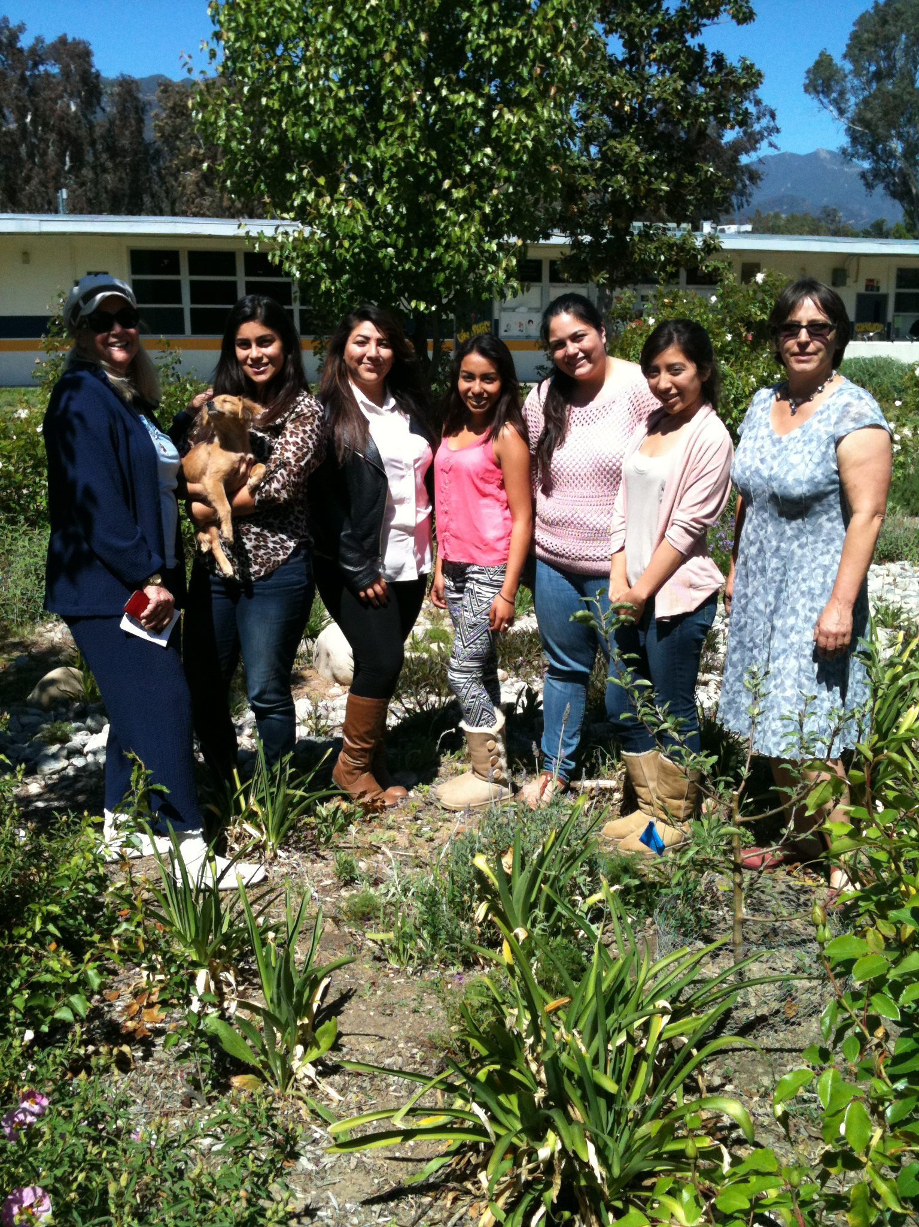
Nordhoff High School Garden
…Diane Ladd & Zack visiting the Nordhoff High School Garden with Science Teacher Becky Beckett & her class!
April 17, 2013

Slide 12
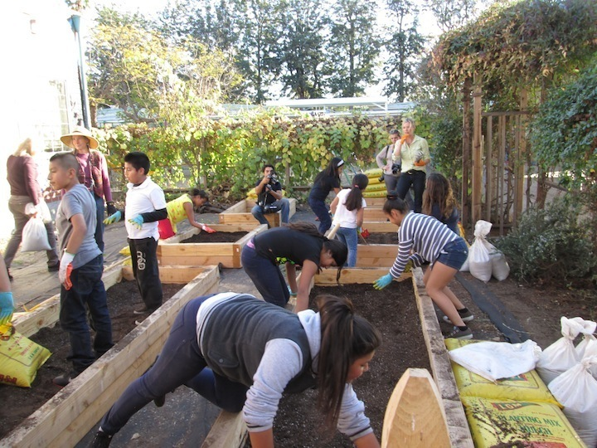
Hollygrove Giving Garden
January 14, 2014

Slide 13
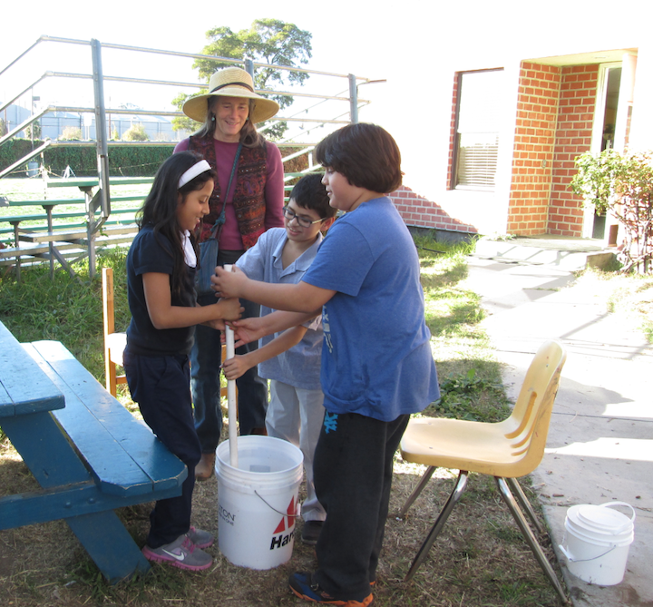
Stirring compost tea…

Slide 14

Why Biodynamics?

Slide 15

Because it works!

Slide 16
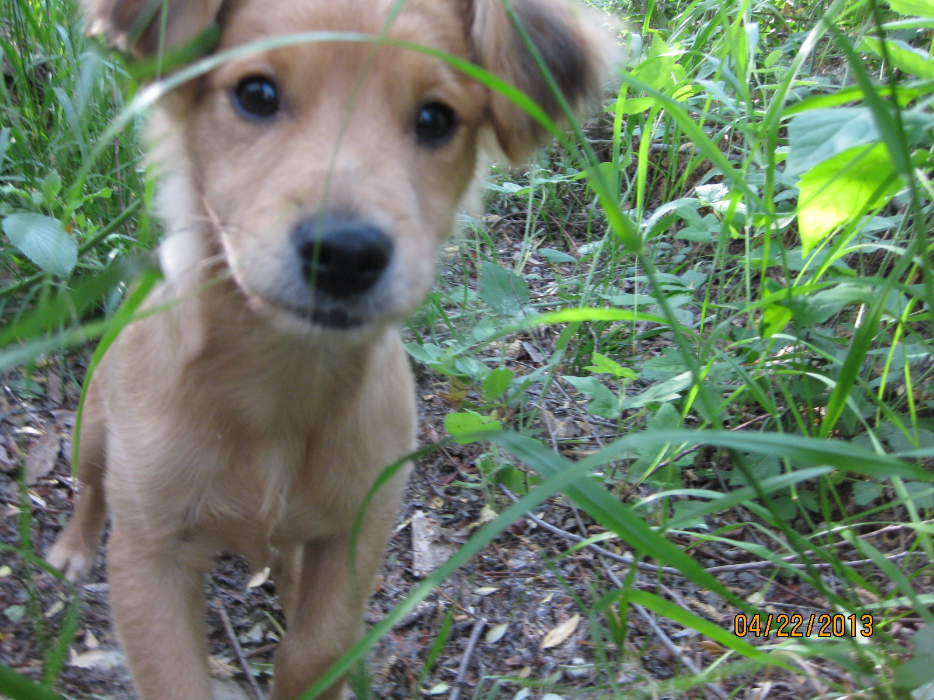
Zack’s Organics
We have Sacred Cow Biodynamic Compost to enliven the soil!
Great for landscapes, gardens, orchards and farms!

Slide 17
Benefits of Biodynamic Compost
Creates healthy soil
Cuts down water usage
Reduces or Eliminates Pest, Disease & Fungus Problems

Slide 18
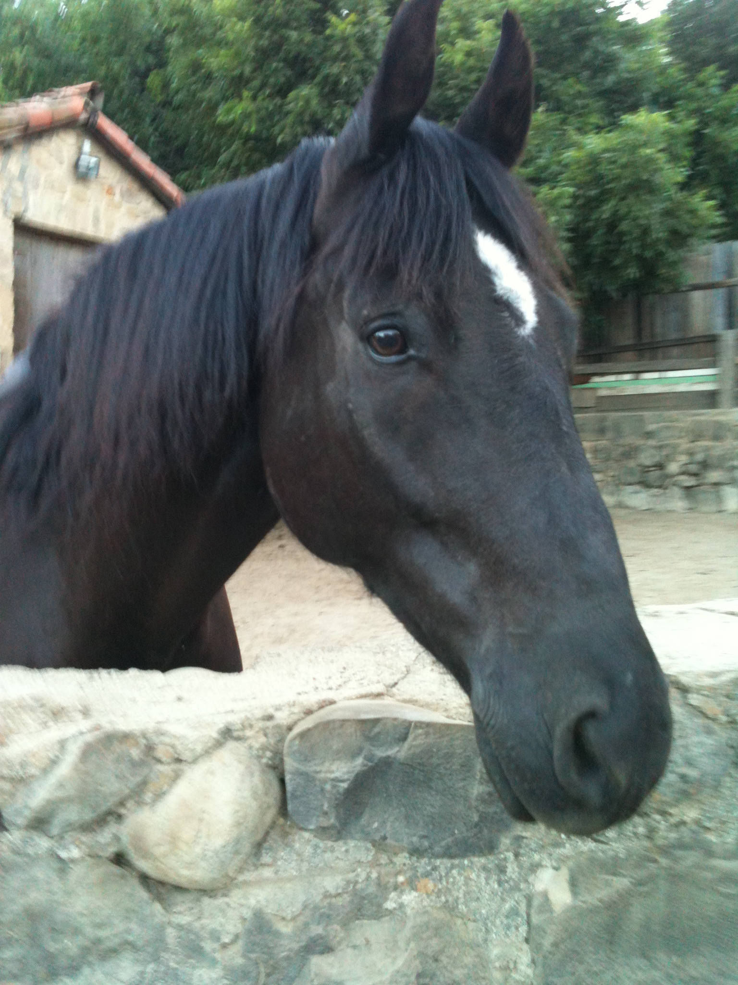

Zack’s Organics now has California Grown, Certified Organic Alfalfa Hay available!

Slide 19
Transition to Organics Team
Steve Sprinkel (Farmer & the Cook, Rancho Del Pueblo Farm)
Matt Boeck (organic horticulturist and pest control advisor)
Basia Kenton (garden designer)
Gena Nonini (biodynamic expert and land manager for Marian Farms)
They are available for consultation and advice on how to best begin and follow through with transitioning to organics.

Slide 20
Healthy Solutions for Weed Control
Site-specific, efficient and timely use of safe alternatives, such as vinegar, flame torching (in spring, when weeds are just emerging), mulching, sheet mulching, utilizing goats as weed control, and other alternative methods.

Slide 21
Healthy Soil = Healthy Plants!
...Scientists are also discovering that a healthy soil ecosystem may sustain plants naturally, without chemical inputs. “The greater the soil diversity, the fewer diseases that emerge in plants,” said Eric B. Nelson, who studies soil and disease ecology at Cornell. Insects are also deterred by plants grown in healthy soils, he said.
http://www.nytimes.com/2013/05/12/opinion/sunday/the-hidden-world-of-soil-under-our-feet.html?pagewanted=all

Slide 22
Safe, Alternative Treatments for Asian Citrus Psyllid
Remember: Healthy Soil = Healthy Trees!
Enliven & Enrich the Soil with Organic/Biodynamic Compost.
“Soaps may be effective as an alternative to conventional pesticides to manage psyllid adults and nymphs and in areas where conventional pesticides cannot be used, such as organic groves and urban landscapes.”
http://www.ars.usda.gov/research/publications/publications.htm?seq_no_115=275704
LA County Plant Pathologist stated that for the Asian Psyllid, there are effective alternative organic preventives & treatments, such as Neem Oil & Soap, and the beetle and wasp predators.

Slide 23
We gratefully accept tax-deductible donations to continue & expand our work!
www.transition-to-organics.org
ph: 805-646-4294
You can donate online, or send your tax-deductible donation, check payable to:
Blackbird Foundation,
with notation: for TTO
Mail check to: Transition to Organics 1129 Maricopa Hwy, #190,
Ojai, CA 93023

Slide 24

Thank you!

